Slide 1
RTF file fuzz
—by Maldiohead

Slide 2
About me:
Security researcher@360
Focus on :
1)Malware reverse analysis.
2)windows kernel, office vulnerability fuzz& analysis(
find a office vulnerability:MS address CVE-2016-7275).
3) develop emulator now (run windows pe file ,vbs ,js script).

Slide 3
Agenda:
1.RTF File format
2.RTF attack interface
3.A rtf fuzz tool write by me

Slide 4
RTF file format
Rtf file just like a container(you can drop text ,video,pdf,pic.etc).with the help of ole .(which is a way to attack system).
Rtf own a huge key words.(another vulnerability interface).
Rtf syntax very loose(so it will be lead to some security issues).

Slide 5
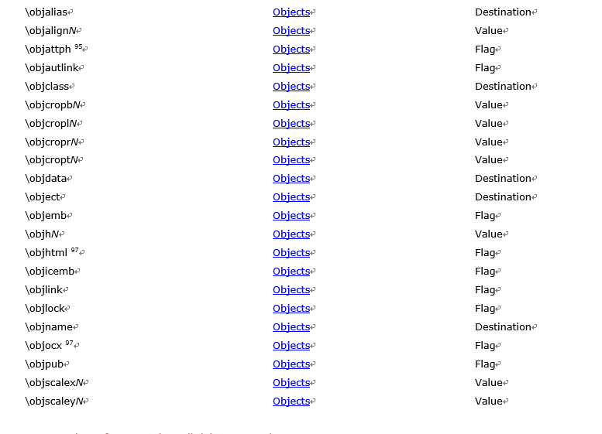
Ole object in RTF file:
Key words about OLE object in RTF file:
#PCDATA Text (without control words)
#SDATA Hexadecimal data
#BDATA Binary data

Slide 6
<objdata> '{\*' \objdata (<objalias>? & <objsect>?) <data> '}'
\objdata This sub-destination contains the data for the object in the appropriate format; OLE objects are in OLESaveToStream format. This is a destination control word.
\objalias This sub-destination contains the alias record of the publisher object for the Macintosh Edition Manager. This is a destination control word.
\objsect This sub-destination contains the section record of the publisher object for the Macintosh Edition Manager. This is a destination control word.

Slide 7
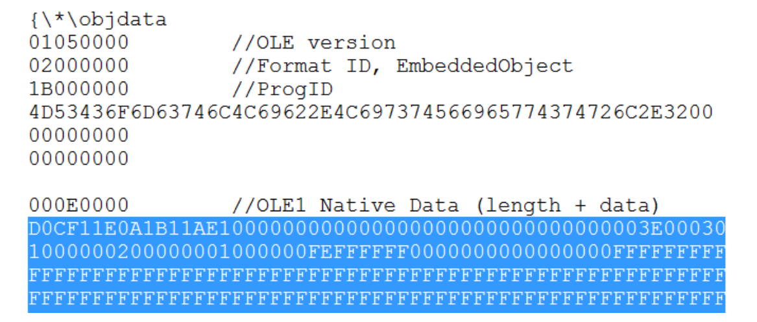
OleSaveToStream format：

Slide 9
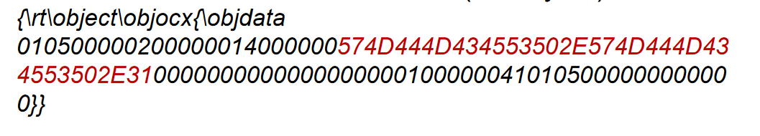
RTF attack interface
By Ole :
1)DLL Preloading Example: OLE Loading(cve-2015-2369/cve-2016- 7275)
ProgID:WMDMCESP.WMDMCESP.1
%systemroot%\System32\cewmdm.dll

Slide 10
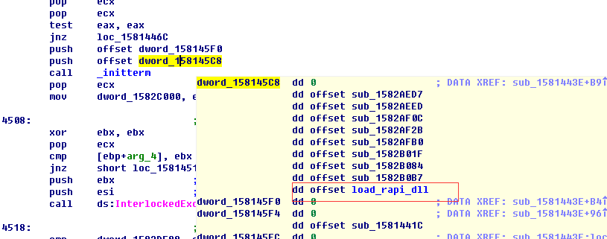
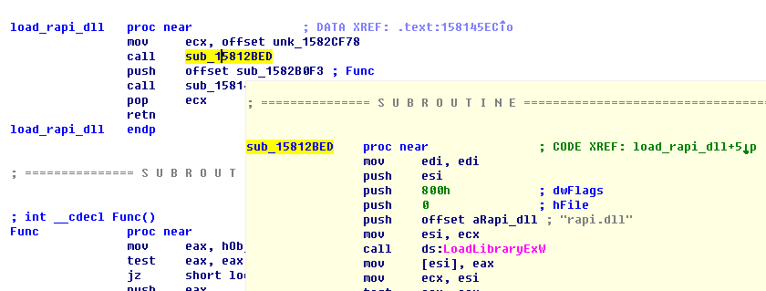

Slide 11
2) Memory Corruption
The dll is not initial well will lead to memory corruption
Eg:cve-2015-1770
https://labs.mwrinfosecurity.com/assets/987/original/mwri_advisory_cve-2015-1770.pdf
Progid:
osf.Sandbox.1 COM

Slide 12
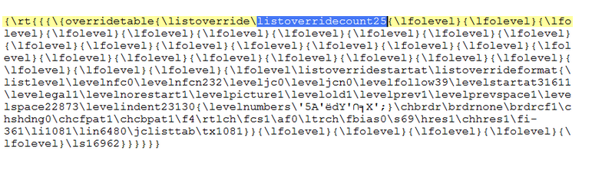
3)Type confusion
Eg:cve-2014-1761(typically object confusion vulnerility)
ListoverridecountN may be 0, 1, or 9.in the exploit this value will be 25

Slide 13
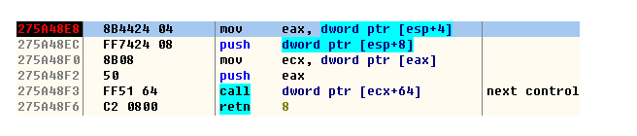
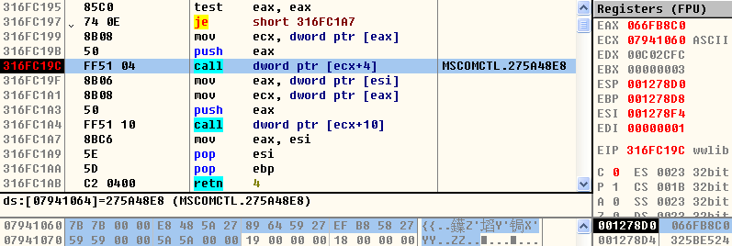

Slide 14
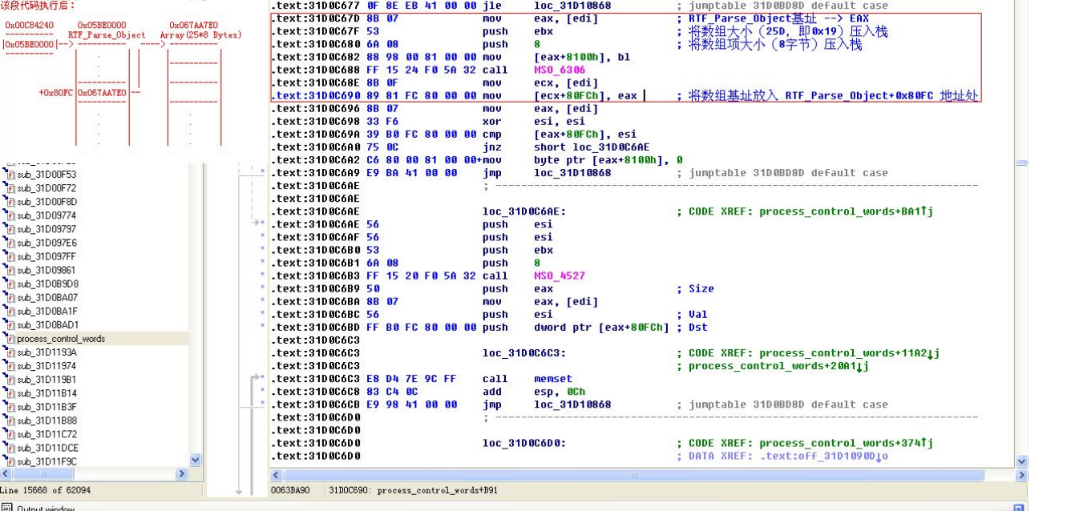

Slide 15
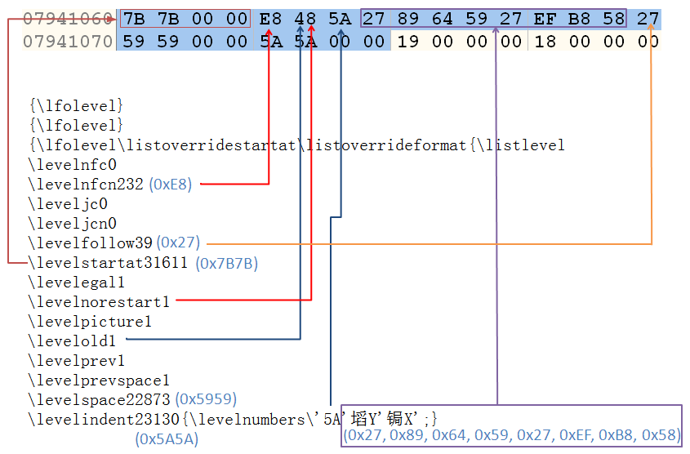

Slide 16
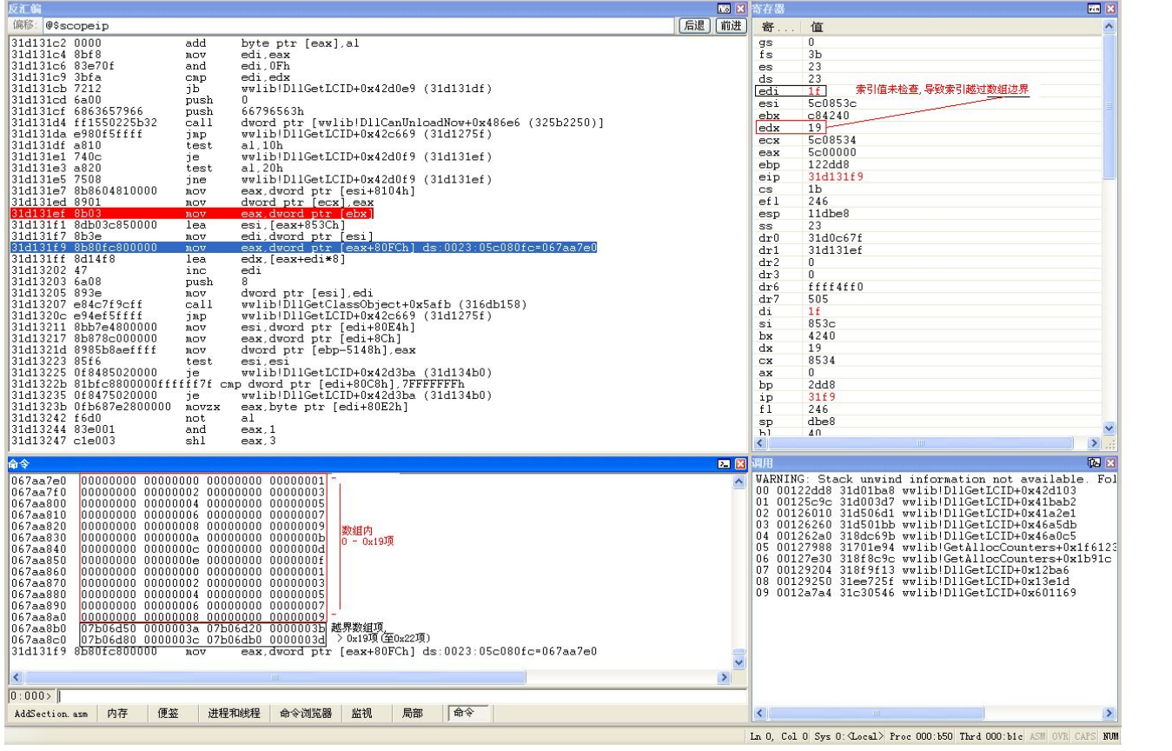

Slide 17
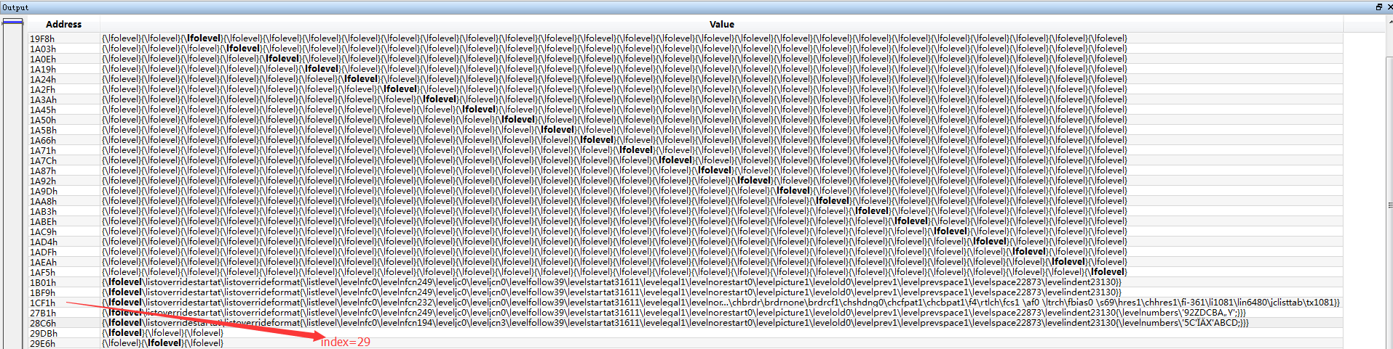
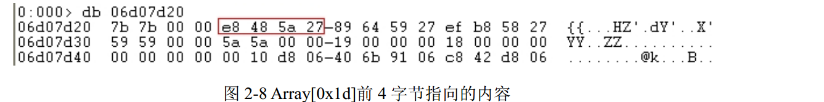
29=0x1d
It’s matched. the object is just lfolevel.

Slide 18
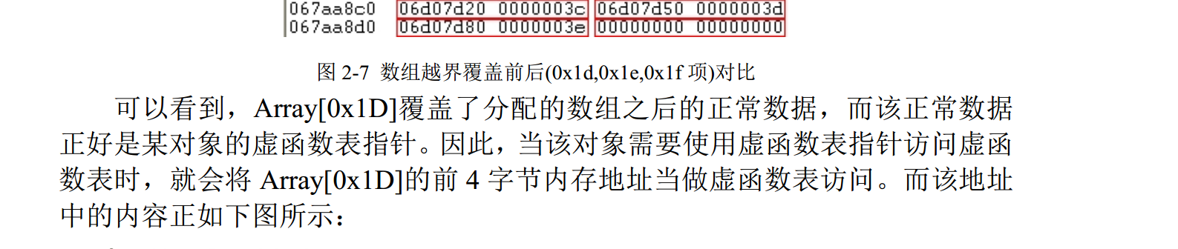

Slide 19
My fuzz tool and a vulnerility
1. json file(contains rtf key words)
2.generate rtf python script
3.monitor program

Slide 20
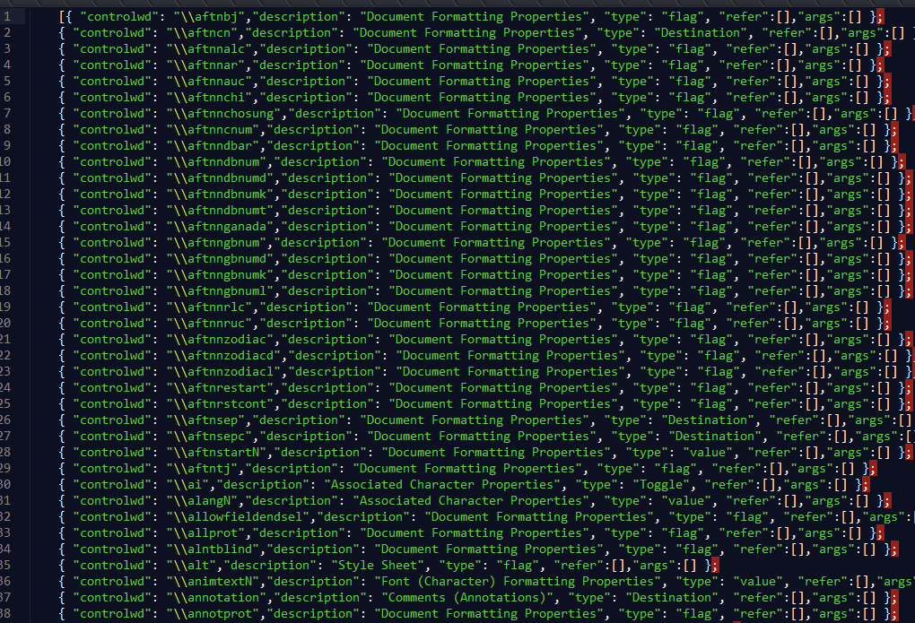

Slide 21
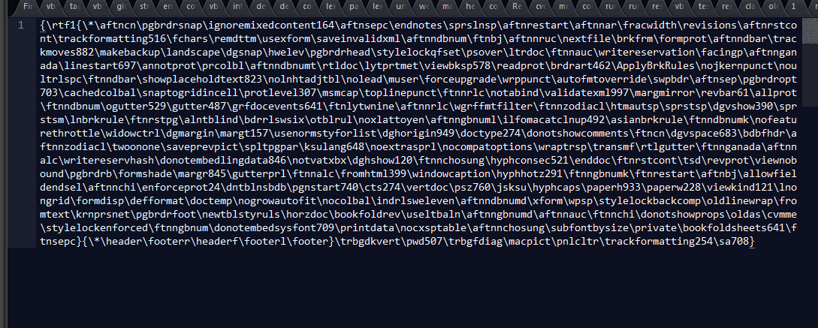
Use key words generate rtf files
Run the rtf file
record exception logs

Slide 22
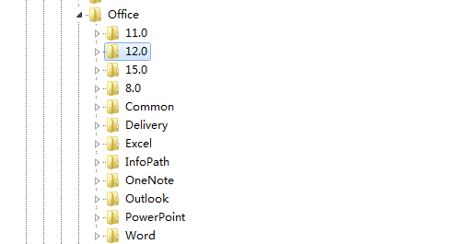
CVE-2016-7275:
由于Microsoft office在初始化运行的时候，会加载默认组建，由于office2007会在注册表中注册一个com组建，SYMINPUT.dll, 对应的注册表键是：HKEY_LOCAL_MACHINE\SOFTWARE\Microsoft\Office\Word\Addins\OfficeSymbol.Connect12 .
而offfice2013在初始化运行阶段会加载这个组建，在关闭文件的时候，office2013会动态加载另一个mstr2tsc.dll,由于这个dll不在默认路径中，在依次搜索：当前目录→system32之后，会尝试搜索文件所在目录，从而造成dll劫持.
微软对该漏洞的修补:

Slide 23
Rtf fuzz tool:
https://github.com/maldiohead/rtffuzz.
More work should do.

